Slide 1


Slide 2
About us
The Largest online information media in the field of disseminating results and other career related information.
Publishing results for
  School Boards
  Universities
  National and state competitive entrance exams
    Engineering
    Medical
    Management
    Pharmacy
    MCA
    B. Ed. …
  Recruitment Examinations
    Railway Recruitment Boards
    Public Service Commissions …

Slide 3
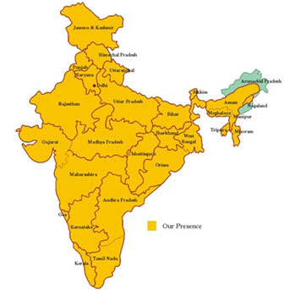
About us (contd.)
Statistics
Pan India Coverage
More than…
  534 million page views
    (Jan – Dec 2012 | Source : Google Analytics)
  57 million student’s results
    (Jan – Dec 2012 | Source : Internal)

Slide 4
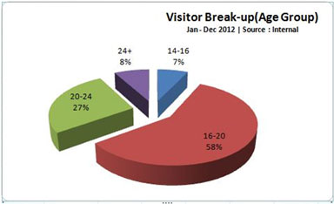
About us (contd.)
Visitor Break up (Age-group)

Slide 5
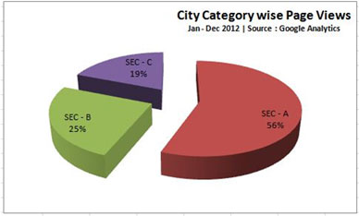
About us (contd.)
Visitor Break up (City Type)

Slide 6
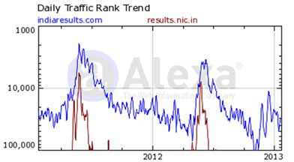
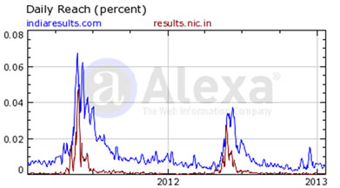
About us (contd.)
Competition
We enjoy nearly NIL competition.
Here is the comparison by Alexa (World renowned website for traffic statistics between http://www.IndiaResults.com
and Govt. of India’s result portal i.e. http://results.nic.in

Slide 7
About us (contd.)
We publish results for major boards and universities.
Partial List of Boards
  Central Board of Secondary Education (CBSE), New Delhi
  Council for Indian School Certificate Examination (CISCE), New Delhi
  National Institute of Open Schooling, New Delhi
  Board of Secondary Education Rajasthan, Ajmer
  Punjab School Education Board, Mohali
  West Bengal Board of Secondary Education, Kolkata
  Madhyamik Shiksha Parishad Uttar Pradesh, Allahabad
  Gujarat Secondary Education Board, Gandhi Nagar
  Madhya Pradesh Board of Secondary Education, Bhopal
  Bihar School Education Board (BSEB), Patna
  A.P. Board of Intermediate Examination, Hyderabad
  Tamil Nadu Board of Secondary Education, Chennai
    …

Slide 8
About us (contd.)
Partial List of Universities
  Osmania University, Hyderabad
  MDS University, Ajmer
  Bhavnagar University, Bhavnagar, Gujarat
  Solapur University, Maharashtra
  HP University, Shimla
  Anna University, Chennai
  Banaras Hindu University, Varanasi
  Kakatiya University, Warangal
  Jiwaji University, Gwalior
  Chhattisgarh Swami Vivekanand Technical University, Bhilai
  Patna University, Bihar
  University of Allahabad, Uttar Pradesh
    …

Slide 9
Advertising Medium

Slide 10
Why Internet ?
Global Reach
Interactive, Instant &
Measurable Response
24 x 7 x 365 availability
Animated / Rich media creatives
Better Value for Money

Slide 11
Why IndiaResults ?
No. 1 destination for results
Targeted visitors / Age-group
Pan-India coverage
Regional Home pages for better geographical targeting
Combined benefit of web as well as PRINT media
(as most of the students take print-out of their marks memo.)
Flexible advertising solutions

Slide 12
How we promote ?
Awareness by Boards / Universities
  Official press releases (Print/ Website/ TV/ Radio)
  Advertisements / Prospectus / Brochures
Cross Media Promotions
  TV
  Print
  Outdoor (Hoardings)
  Web (Banners/ Text)
  Search Engines
Events
  Sponsorships
  Online media partnerships
Alliances
  Promotions
  During dissemination with every SMS / IVRS

Slide 13

How we promote ?
Click on Image to see the complete Video
TV Commercial Released on Youth & News Channels during 2012

Slide 14
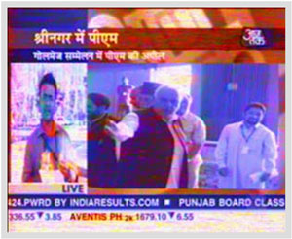
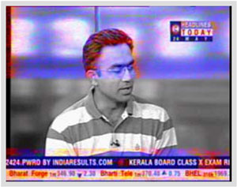
How we promote ? (contd.)
Powered by IndiaResults.com
Powered by IndiaResults.com

Slide 15
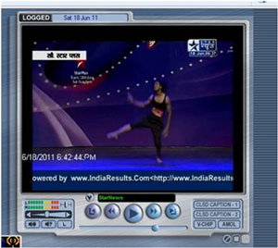
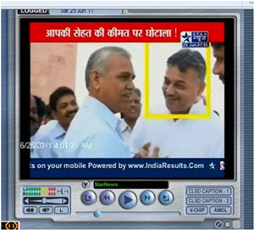
How we promote ? (contd.)
Powered by IndiaResults.com
Powered by IndiaResults.com

Slide 16
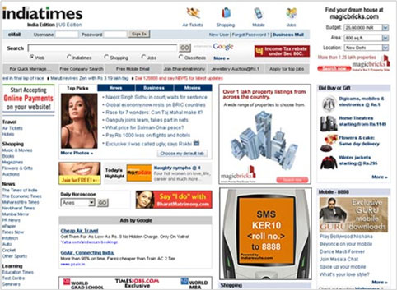
How we promote ? (contd.)
Powered by IndiaResults.com

Slide 17
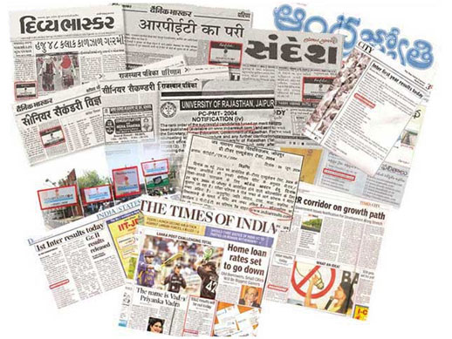
How we promote ? (contd.)

Slide 18























Partial Clientele

Slide 19
Advertiser testimonials
As a new Institute, It is imperative that we advertise online effectively. In developing our presence on the IndiaResults.Com web site, we have experienced extremely courteous, efficient and responsible customer service from the IndiaResults team. Further once our presence was established, we had an impressive number of enquiries. Beyond sheer volume, the inquiry information was forwarded to us in a very timely and succinct manner. The pleasurable process has yielded excellent results.
Dr. Nagesh Bhandarii, Chariman, Ahemdabad Aviation and Aeronautics Ltd, Ahemdabad
We first came across IndiaResults when Saurabh had just 2 people advertising on his site, We could see that the idea was going to capture the imagination and explode, so we went for it and bought. We were all alone up there. Overnight we saw an increase of queries from students across the country. We are simply happy to support an entrepreneur who has that kind of imagination to come up with a brilliant idea. We are even happier with the results we received from our investment. To this day IndiaResults.Com still remains our largest referrer.
Mr. Shashi Kant Singhi, Director, Poornima University, Jaipur
IndiaResults.Com has been an excellent tool for getting the word out to students about our programs. We continually receive well-qualified applicants through IndiaResults, most of whom convert into enrolled students. We are very pleased with the results and the service provided by them.
Mr. Naveen Maheshwari, Director, Allen Career Institute, Kota
We have tried every type of advertising for the campaigns from TV to Print to Outdoors. IndiaResults.Com has given us the best deal and the most targeted response out of all of our advertising efforts. You provide great prices and better results.
Ms. Archana Sehgal, Director (Brand-development), Lovely Professional University, Punjab
JECRC offers Masters and Bachelor courses in a range of areas. Our students are serious about their careers and serious about getting ahead. IndiaResults.Com provided an economical and efficient way for JECRC to reach out to diverse constituency of career minded focused students. Last year alone we received thousands of quality leads. We would have no hesitation in encouraging potential advertisers to use IndiaResults.Com as a result of our experience.
Mr. Amit Agarwal, Director, JECRC, Jaipur

Slide 20
Advertising Options

Slide 21
Options
  Fixed Location Banners
  Rotational Banners
    (CPM / CPC campaigns)
  Text Advertisements
    (Fixed and rotational (Marquee))
  Mailers to registered user base
    (1,55,000+ and increasing)

Slide 22
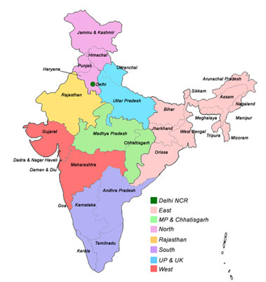
Options
Regional Home Pages:-
  Enhanced visitor experience
  Better geo-graphical targeting
  Better conversion rate
  Better value for money

Slide 23
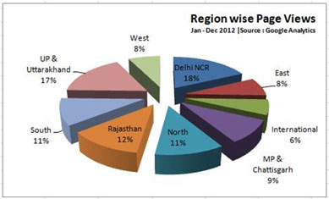
Options
Regional Break-up
Delhi NCR | National Capital Region
East | Arunachal Pradesh, Assam, Bihar, Jharkhand, Manipur, Meghalaya, Mizoram, Nagaland, Orissa, Sikkim, Tripura, West Bengal, Andaman & Nicobar Islands
MP & Chhatisgarh | Madhya Pradesh, Chhatisgarh
North | Haryana, Himachal Pradesh, Jammu & Kashmir, Punjab
Rajasthan | Rajasthan
South | Andhra Pradesh, Karnataka, Kerala, Pondicherry, Tamil Nadu, Lakshadweep
UP & UK | Uttar Pradesh, Uttarakhand
West | Goa, Gujarat, Maharashtra, Dadra & Nagar Haveli, Daman & Diu
International | All traffic generating from out side of India

Slide 24
Options: Inventory
Home Page:-
S No. | Property | Location | Specs | Max Size
1 | Left Stamp | Left | 120 x 40 Px. | 3 KB
2 | Left Banner | Left | 120 x 80 Px. | 5 KB
3 | Left Side Banner (Expandable) | Left | 120 x 80 Px. => 300 x 80 Px. | 8 KB
4 | Right Banner | Right | 200 x 100 Px. | 8 KB
5 | Leader Banner | Top | 728 x 90 | 20 KB
6 | Centre Banner | Centre | 468 x 50 Px. | 12 KB
7 | Magnet Strip | Bottom | 600 x 40 Px. | 20 KB
8 | Text Marquee | Top | Rotating Text | 80 Char.
Results Pages (Board / University):-
Click on respective property for actual size functional animated sample.
S No. | Property | Location | Specs | Max Size
1 | Side Stamp | Left / Right | 120 x 40 Px. | 3 KB
2 | Side Banner | Left / Right | 120 x 80 Px. | 5 KB
3 | Side Banner (Expandable) | Left / Right | 120 x 80 Px. => 300 x 80 Px. | 8 KB
4 | Bottom Banner | Bottom | 468 x 60 Px. | 12 KB
5 | Intermediate Banner | Intermediate | 300 x 250 | 20 KB
6 | Leader Banner | Top | 728 x 90 | 20 KB
7 | Text Marquee | Top | Rotating Text | 80 Char.

Slide 25
Home Page

Slide 26
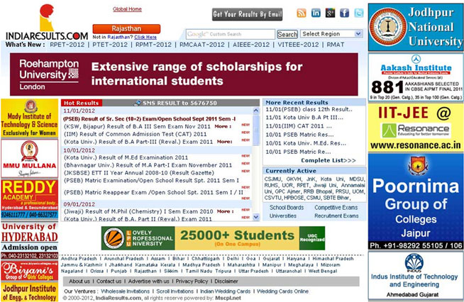
Options: Home Page
Right Banner
200 x 100 Px.
Leader Banner
728 x 90 Px.
Left Banner 120 x 80 Px.
Left Stamp 120 x 40 Px.
Centre Banner 468 x 50 Px.

Slide 27
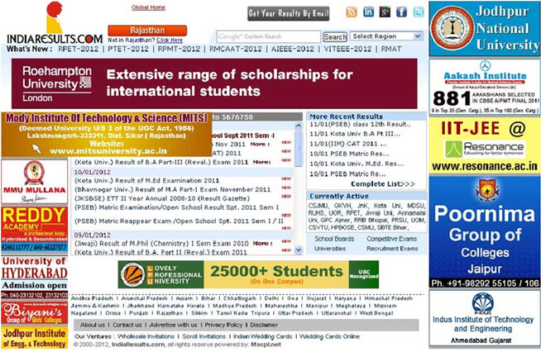
Options: Home Page: Left banner expandable
Left Banner (expandable)
120 x 80 Px. =>
300 x 80 Px.
It expands on mouse hover.
Click for live sample

Slide 28
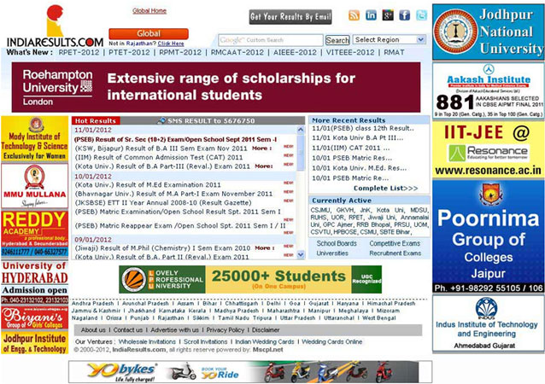
Options: Home Page: Magnet Strip
It remains on screen even when the user scrolls the page.
Click for live sample
Magnet Strip
600 x 40 Px.

Slide 29
Results Pages
(Board / University)

Slide 30
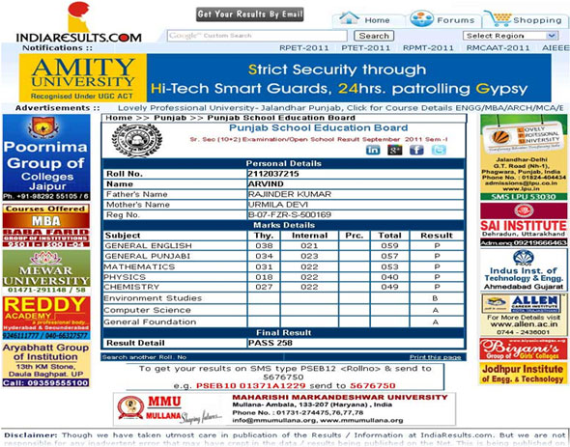
Options: Results Pages
Leader Banner
728 x 90 Px.
Side Banner 120 x 80 Px.
Bottom Banner 468 x 60 Px.
Side Stamp 120 x 40 Px.

Slide 31
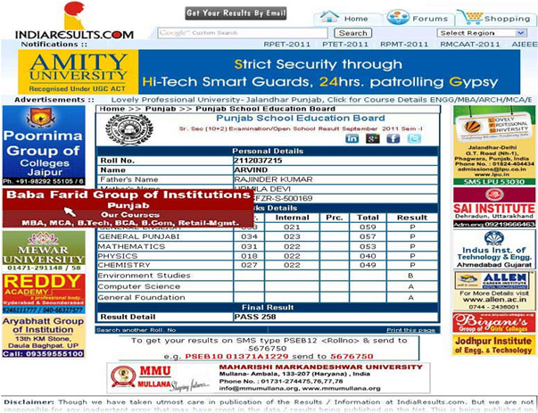
Options: Results Pages
Side Banner (expandable)
120 x 80 Px. =>
300 x 80 Px.
It expands on mouse hover.
Click for live sample

Slide 32
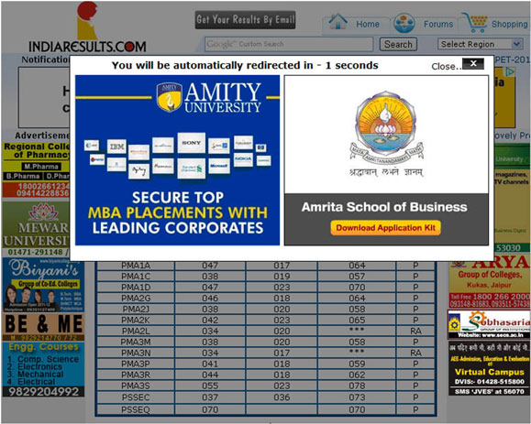
Options: Results Pages: Intermediate Banner
Intermediate Banner
300 x 250 Px.
It will appear for 15 seconds before the actual page
Click for live sample

Slide 33
Options: More…
E-mailers (1,55,000+ users)
Pop ups
Pop unders
Surveys
(on daily / weekly basis)

Slide 34

Contact
It will be a pleasure to work with your team to formulate a custom media plan based on your desired target audience and campaign goals.
Please feel free to contact with your queries.
Thank You

Slide 35
Contact
Corporate Office
IndiaResults.com
(A Unit of Monsoon Software Consulting P. Ltd.)
IT-4, EPIP
RIICO Industrial Area, Sitapura
Jaipur 302 022 (RAJ) India.
+91-141 277 1080 - 81(PBX Lines)
+91-141 277 1082 (Fax)
Saurabh Agarwal, Director
(+91-982 906 7113)
saurabh@indiaresults.com
Sumit Gilhotra, GM (Operations)
(+91-982 903 6113)
sumit@indiaresults.com
Aamir Malik, Dy. GM (Marketing)
(+91-982 943 1113)
aamir@indiaresults.com
Mayank Sharma, Asstt. Manager (Marketing)
(+91-992 839 9113)
mayank@indiaresults.com

